Slide 1
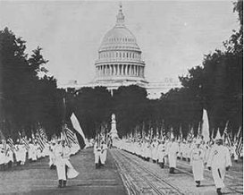
The 1920’s Age of INTOLERENCE

Slide 2
``
The concerns of “Big Business”
are always favored over those of the
workers.

Slide 3
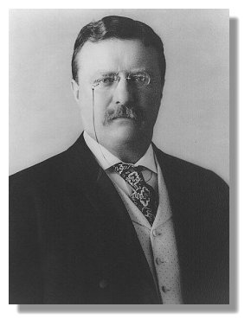
The
“Square Deal.”
Pres. Roosevelt
offers both
business & labor
equal consideration.
Pres. 1901-1909

Slide 4
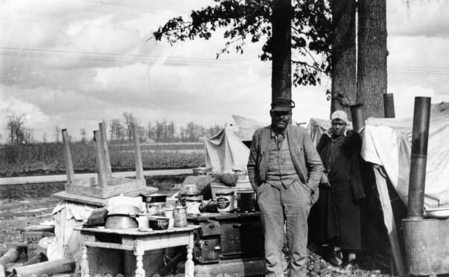
African-Americans find many
“Progressive” reforms are not helping them.

Slide 6
Alcohol abuse causes problems for manyAmerican families. Women started the Temerance Movement to rid Americans of the Alcohol Vice.
-It is headed by Carrie Nation

Slide 7
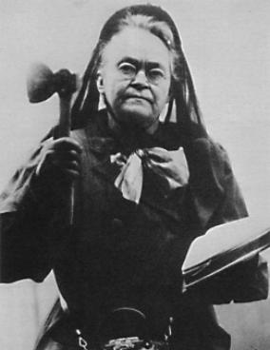
Carrie
Nation
leads
A
“Temperance
Movement.”

Slide 8
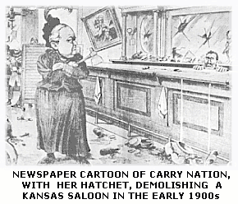

Slide 10
1920
The 18th Amendment is passed
“Prohibition” becomes the law of the land.
The sale, possession, or manufacturing of
alcohol is made illegal. (Volstead Act)

Slide 11
Following WWI, the US economy
was hit by both a recession and inflation.
Labor unrest began to spread across
the country.
In 1919, a general strike shut down Seattle.
Also in 1919, the Boston Police
force went on strike.
The “Red Scare” – Many Americans
associated these strikes with the arrival
of New Immigrants from Eastern Europe
and the Russian Revolution.

Slide 12
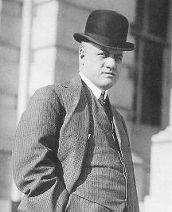
The Palmer Raids
1919-1920
Over 4,000 suspected
communists
and political radicals are
rounded up and arrested
w/o warrants.
The immigrants
Among them are deported
w/o trials.
Attorney General
A. Mitchell Palmer

Slide 13
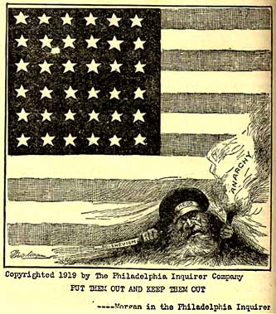

Slide 14
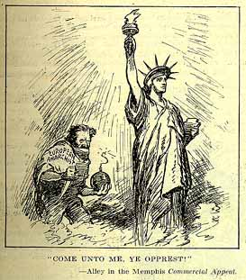

Slide 15
The “Palmer Raids”- As a result
of the “Red Scare” Attorney General
Mitchell Palmer began a series
of raids against suspected
radical immigrants.
Thousands of Immigrants
were jailed and
some deported without trial.

Slide 16
In 1921 The Emergency Quota Act was passed slashing immigration particularly from southern and eastern Europe.
(Harding 1921)
FBI and other police agencies were committed to reducing immigrants and “Reds.”

Slide 17
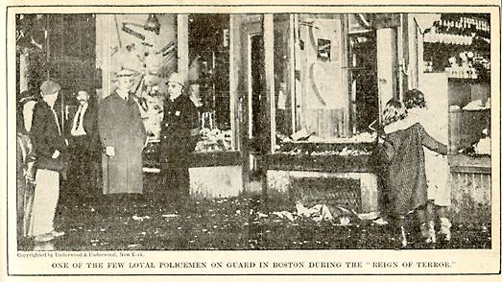

Slide 18
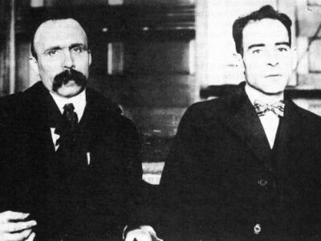
The Sacco & Vanzetti Trial

Slide 19
Two Italian anarchists are arrested
and convicted of robbery and murder.
The trial judge is openly biased against them, and
some people feel they were convicted for their
political views.
During six years of appeals ,
the men become world famous. After all
appeals fail, they are executed in 1927

Slide 20
The Re-emergence of the Ku Klux Klan

Slide 21
Following Reconstruction,
the Ku Klux Klan had almost ceased to exist.
But in the early 1920’s, the Klan re-emerged and
began to gain members even in some northern
cities.
By 1924 the Klan boasted of almost
5 million members.
The new Klan preached hatred against
not only blacks, but Jews, Catholics, and
foreigners, as well.

Slide 22
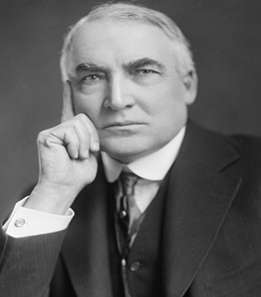
Warren G Harding
Warren G. Harding- 29th Pres of US (1921–1923).
promised a return "normalcy“
rewarded friends and political contributors with powerful positions, Ohio Gang
most notorious scandal was the Teapot Dome affair

Slide 23
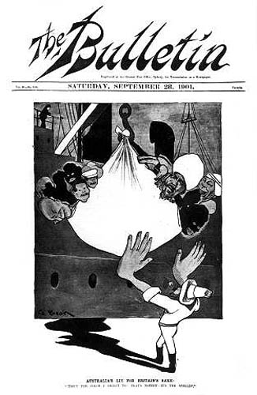
1921 Emergency Quota Act-
reduces immigration numbers
to 3% of 1910 levels.
1924 National Origins Act
Immigration is slashed,
particularly from
southern and
Eastern Europe.
Asian immigration is
completely eliminated.
The 1920’s gets the nickname
The “Age of Intolerence.”

Slide 24
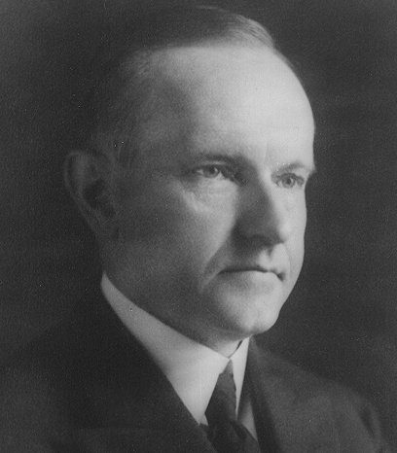
Calvin Coolidge
1923-1928
“ The business of
America is business.”
Stock Market boom
“Silent Cal”

Slide 25
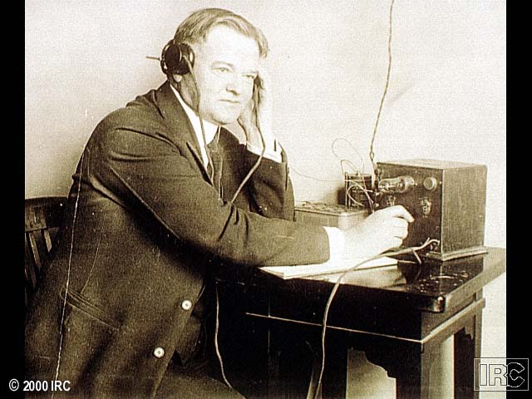
1928 ELECTION
Republican Herbert Hoover

Slide 26
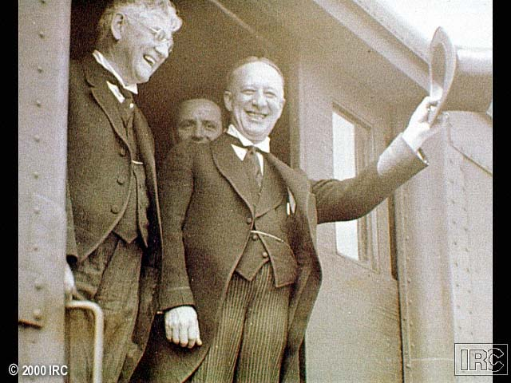
Democrat Al Smith

Slide 27
Hoover | Smith
WASP / self-made millionaire. “Rugged Individualism.” | Catholic, born to poor, immigrant parents.
Rural, small town background. | Born in New York City.
Supported Prohibition, called it the, “Noble Experiment.” | Supported repealing Prohibition.
“Dry” | “Wet”

Slide 28
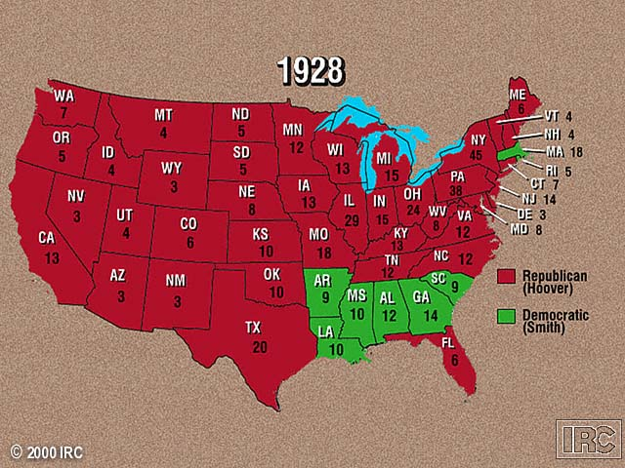

Slide 29
Hoover wins by a landslide and promises,
“ A chicken in every pot,
and two cars in every garage.”

